Slide 1
ASSIGNMENT #3
Measures of Dispersion

Slide 2
Group Members
Ahmed Ali (B20102013)
Annas Baig (B20102078)
Muhammad Amas Waseem (B20102077)
Muneeb Adil (B20102125)
Subhan Ahmed (B20102148)
Syed Zawwar Ahmed (B20102173)
Tayyab Ayub (B20102178)
Zunain Ali Azam (B20102183)

Slide 3
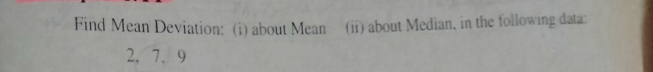
Mean Deviation (UG)
Compute Mean Deviation about “mean” of the following data

Slide 4
Function
function [Coeff_Mean_deviation_mean] = C_M_D_mean(x)
sum_x=sum(x);
n=length(x);
M=sum_x/n;
mean=x-M;
absolute=abs(mean);
sum_mean=sum(absolute); Mean_deviation_mean=sum_mean/n;
end

Slide 5
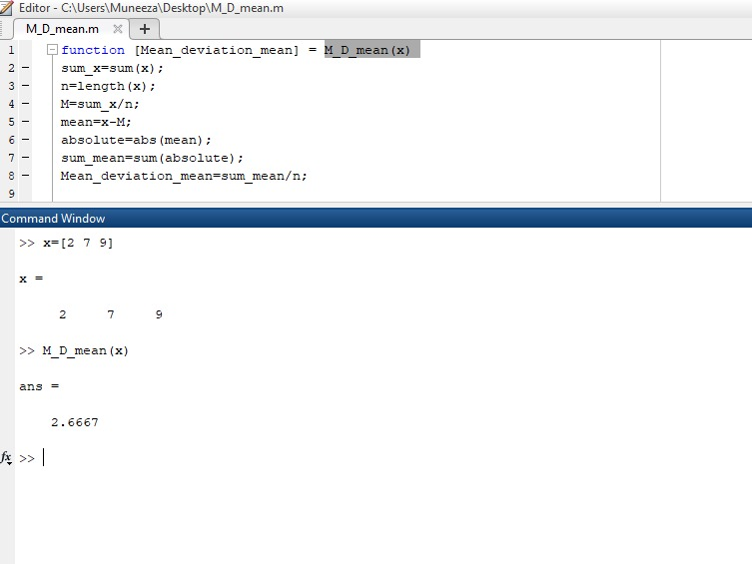
Output of Mean Deviation

Slide 6
Coff-Mean Deviation(UG)
Compute Mean Deviation about “median” of the following data

Slide 7
Function ()
Function [Coeff_Mean_deviation_median] = C_M_D_median
n = length(x);
M = median(x);
Absolute = abs(M);
sum_median = sum(absolute);
Mean_deviation_median = sum_median/n;
Coeff_Mean_deviation_median = Mean_deviation_median/M
end

Slide 8
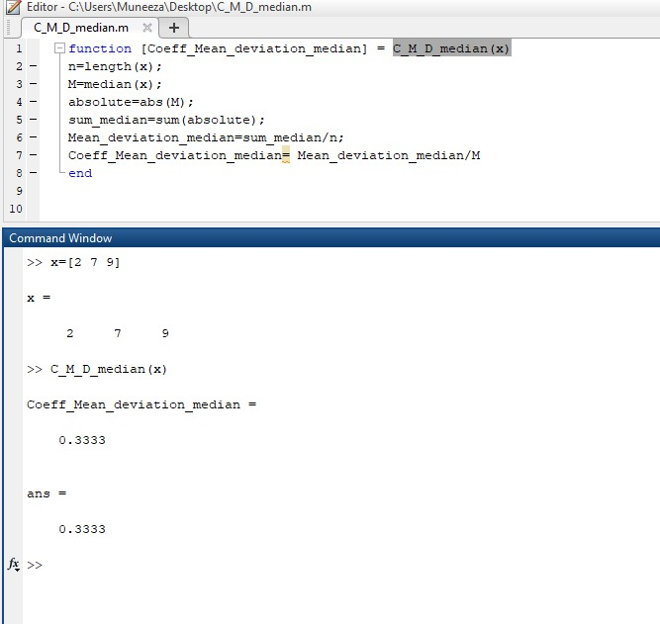
Output of Coff-Mean Deviation about median

Slide 9
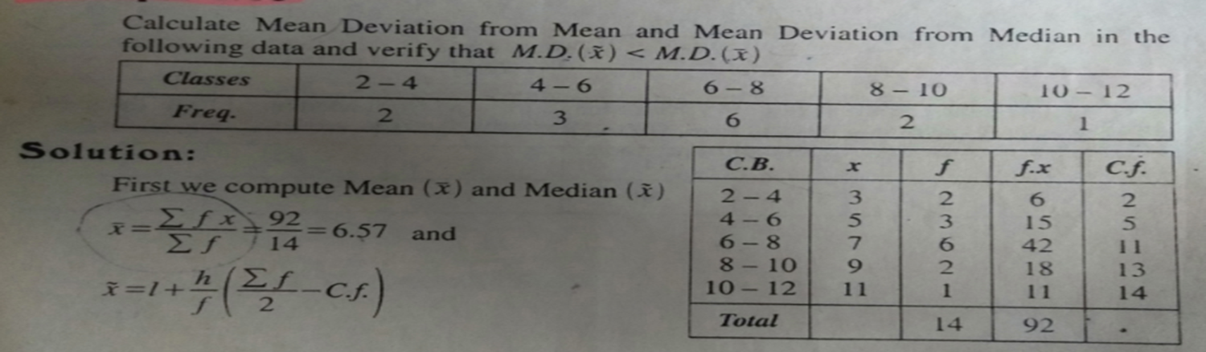
Grouped Mean Deviation (median)
Compute Mean Deviation of the following data

Slide 10
Grouped Function
function [Mean_deviation_median] = M_D_median_grouped(L,U,F)
sum_F=sum(F);
X = (L+U)/2;
x=sum_F/2;
CF=cumsum(F);
j=CF(1);
i=1;
while (j<x)
if(CF(i)>x)
j=CF(i);
obt_median=i;
end
i=i+1;
end
l=L(obt_median);
Pcf=CF(obt_median-1);
f=F(obt_median);
CW=U(1)-L(1);
average=x;
median=l+((average-Pcf)/f)*CW;
m=X-median;
absolute=abs(m);
multiply_median=F.*absolute;
sum_median=sum(multiply_median);
Mean_deviation_median=sum_median/sum_F;
end

Slide 11
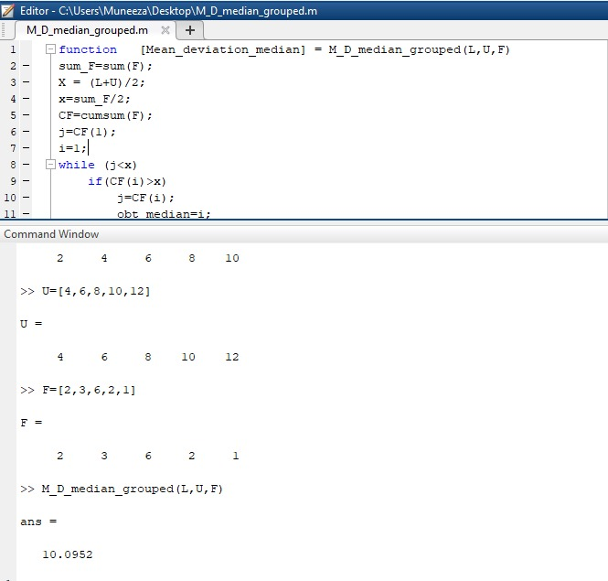
Output of Grouped Mean Deviation(median)

Slide 12
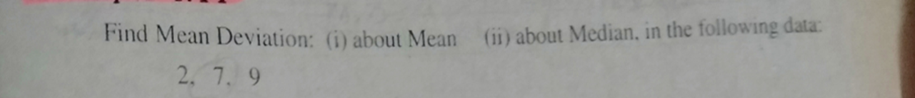
Co-efficient of Mean Deviation (UG)
Compute the Co-efficient of Mean Deviation of the following data

Slide 13
Function (UG, Co-Mean)
function [Coeff_Mean_deviation_mean] = C_M_D_mean(x)
sum_x=sum(x);
n=length(x);
M=sum_x/n;
mean=x-M;
absolute=abs(mean);
sum_mean=sum(absolute); Mean_deviation_mean=sum_mean/n;
Coeff_Mean_deviation_mean=Mean_deviation_mean/M;
end

Slide 14
Function (UG, Coff_MD_Median)
function [Coeff_Mean_deviation_median] = C_M_D_median(x)
n = length(x);
M = median(x);
absolute = abs(M);
sum_median = sum(absolute); Mean_deviation_median=sum_median/n;
Coeff_Mean_deviation_median = Mean_deviation_median/M;
end

Slide 15
Output of Co-efficient of Mean Deviation (median)

Slide 16
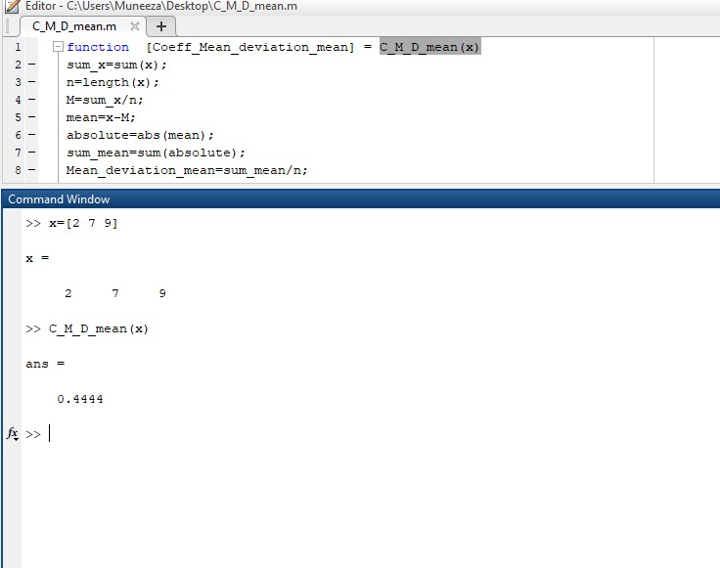
Output of Co-efficient of Mean Deviation (UG, mean)

Slide 17
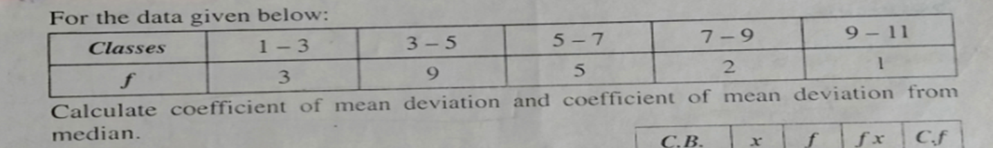
Grouped Coefficient of Mean Deviation (median)
Compute Coefficient of Mean Deviation about Median of the following data

Slide 18
Grouped Function(G, coff-median)
function [Coeff_Mean_deviation_median] = C_M_D_median_grouped(L,U,F)
sum_F=sum(F);
X = (L+U)/2;
x=sum_F/2;
CF=cumsum(F);
j=CF(1);
i=1;
while (j<x)
if(CF(i)>x)
j=CF(i);
obt_median=i;
end
i=i+1;
end
l=L(obt_median);
Pcf=CF(obt_median-1);
f=F(obt_median);
CW=U(1)-L(1);

Slide 19
average=x;
median=l+((average-Pcf)/f)*CW;
m=X-median;
absolute=abs(m);
multiply_median=F.*absolute;
sum_median=sum(multiply_median);
Mean_deviation_median=sum_median/sum_F;
Coeff_Mean_deviation_median= Mean_deviation_median/median;
end

Slide 20
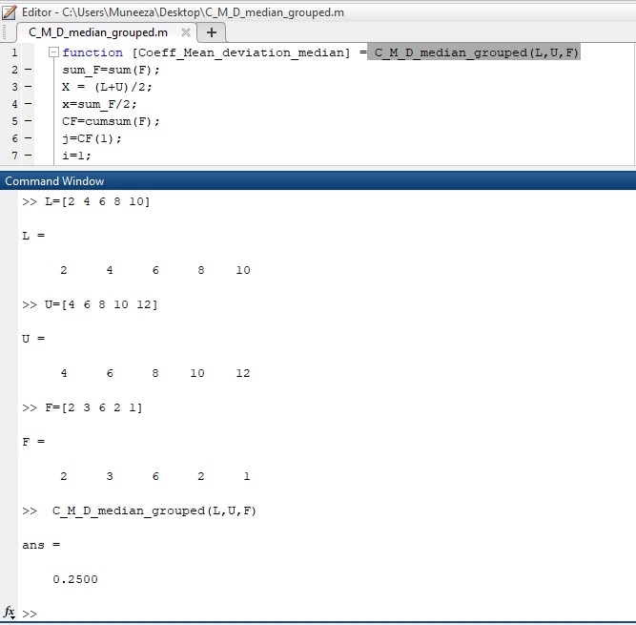
Output of Grouped Co-efficient of Mean Deviation (median)

Slide 21
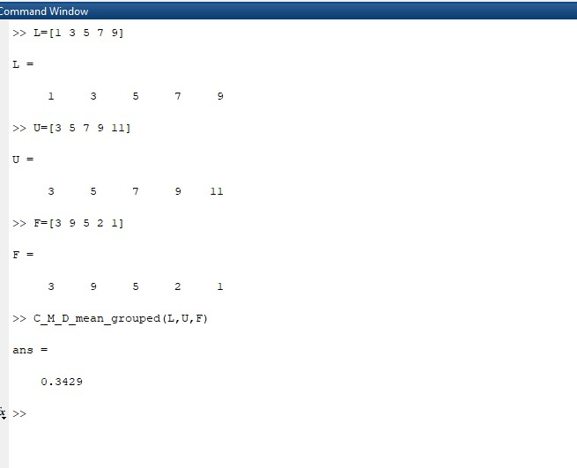
Output of Grouped Co-efficient of Mean Deviation (mean)

Slide 22
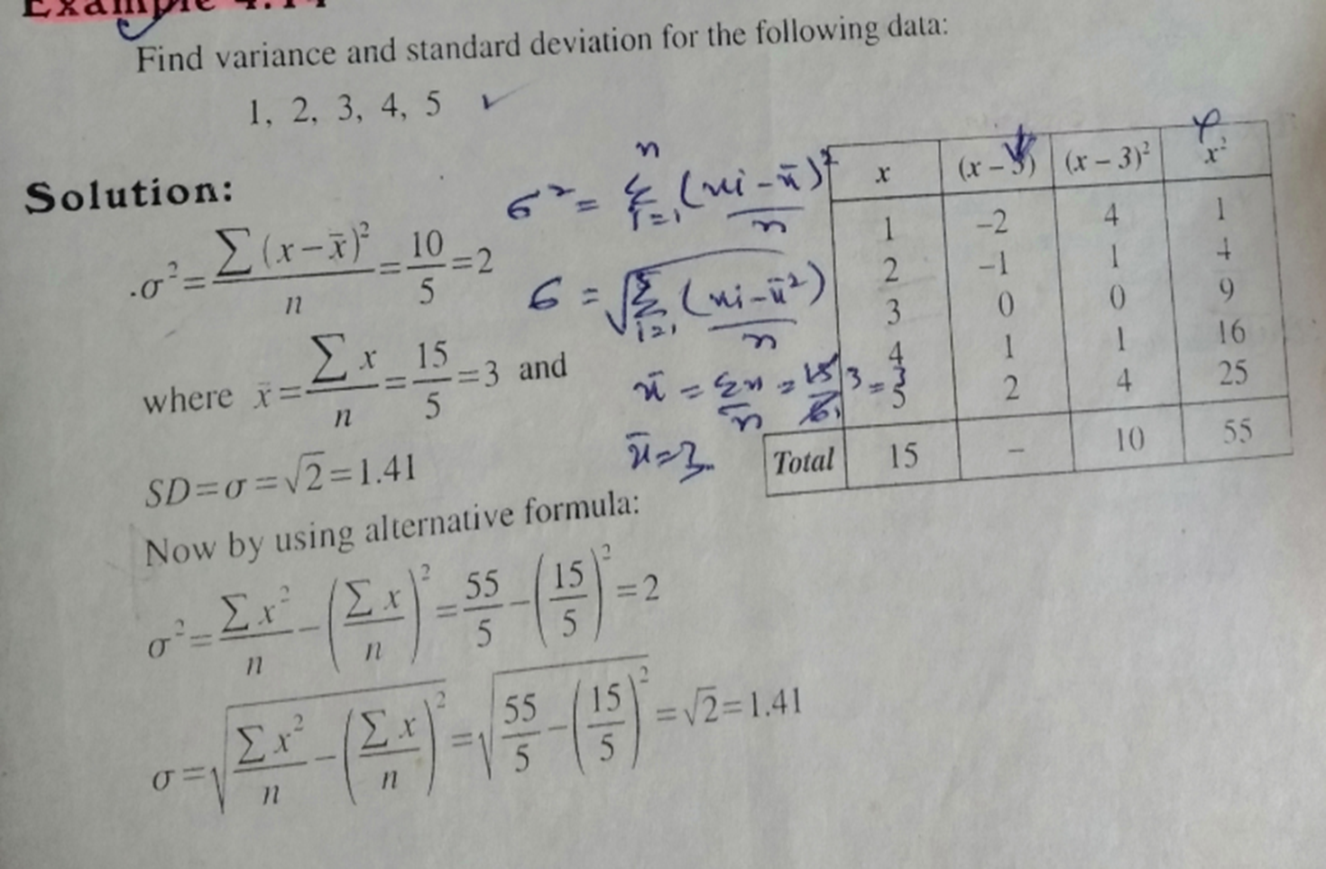
Variance and Standard Deviation (UG)
Compute Variance and Standard Deviation of the following data

Slide 23
Function (UG_Variance)
function [Ungrouped _Variance] = UG_Variance(x) % Variance for ungrouped data
n = length(x); % n = no. of observations
sum_x = sum(x);
a = (sum_x/n)^2;
xx = x.*x;
sum_xx = sum(xx);
b = (sum_xx/n);
Ungrouped_Variance = b-a;
end

Slide 24
Function (UG_SD)
function [Ungrouped_SD] = UG_SD(x) %standard deviation for ungrouped data
n = length(x); % n = no. of observations
sum_x = sum(x);
a = (sum_x/n)^2;
xx = x.*x;
sum_xx = sum(xx);
b = (sum_xx/n);
c = b-a;
Ungrouped_SD = sqrt(c);
end

Slide 25
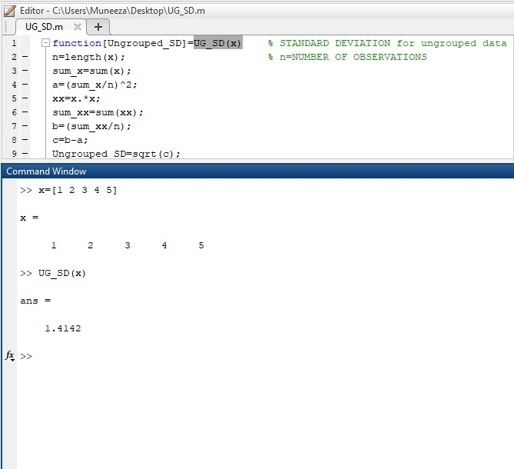
Output of Standard Deviation (UG)

Slide 26
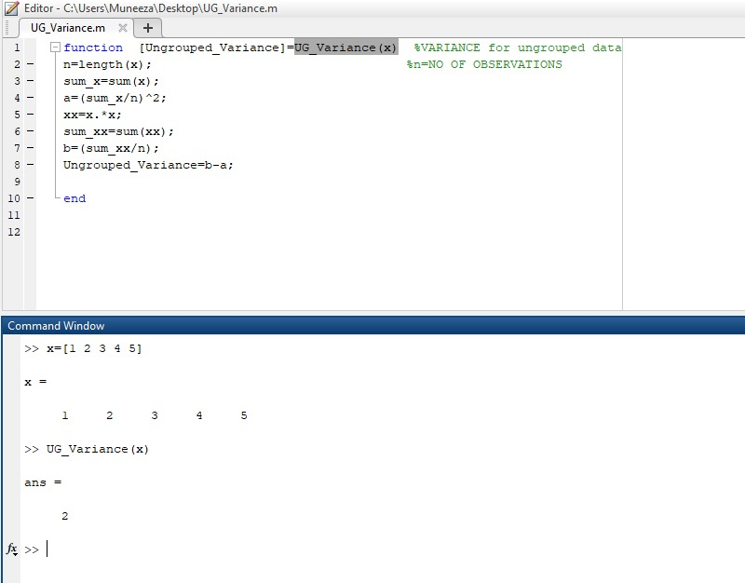
Output of Variance (UG)

Slide 27
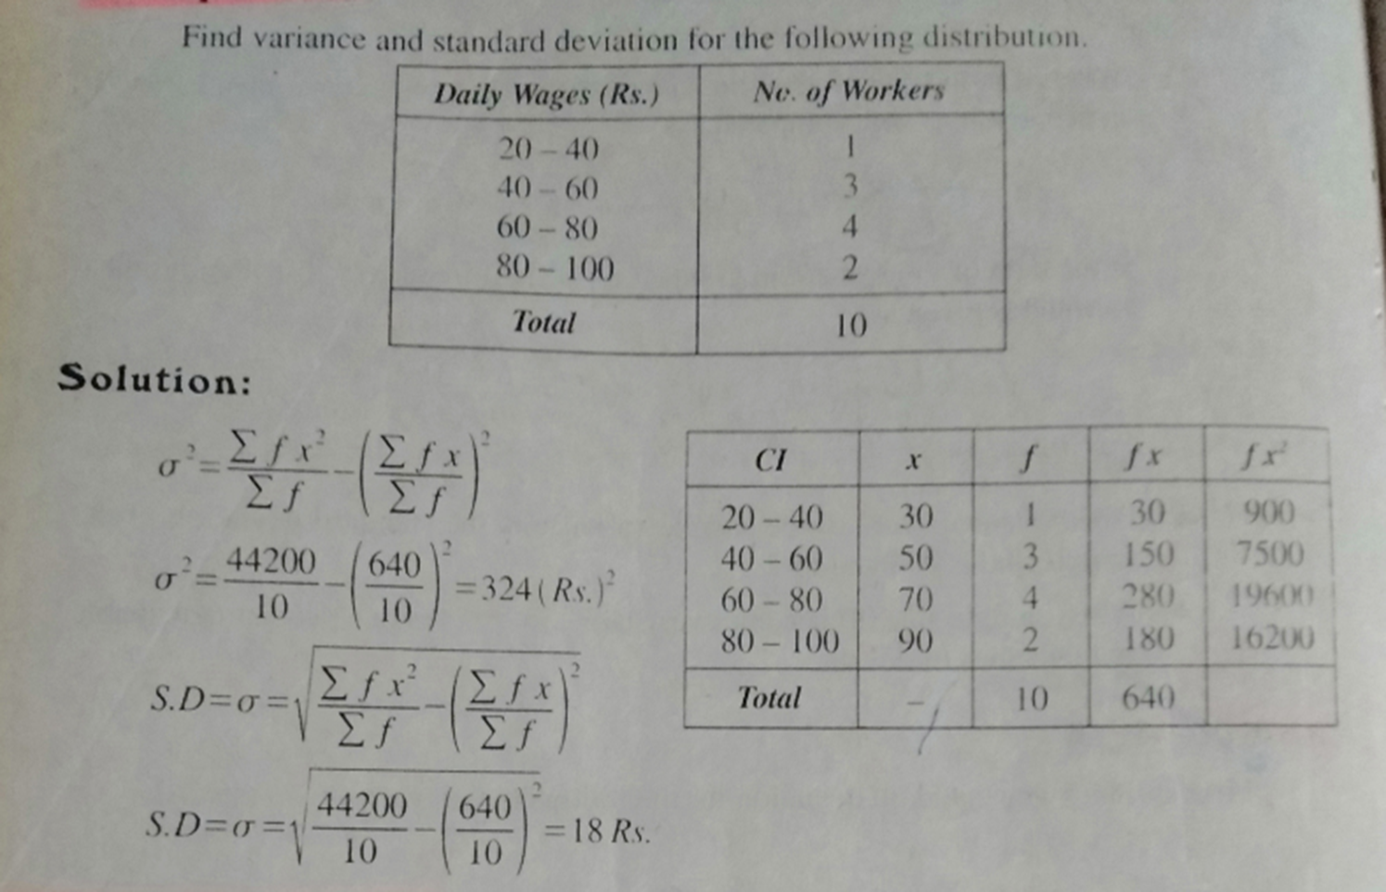
Grouped Variance and Standard Deviation
Compute Variance and Standard Deviation of the following data

Slide 28
Grouped Function (SD)
function [Grouped_SD] = G_SD(L,U,f) % STANDARD DEVIATION for grouped data
sum_f = sum(f);
x = (L+U)/2; % X=MID POINTS
fx = f.*x;
sum_fx = sum(fx);
A = (sum_fx/sum_f)^2;
xx=(x.*x);
fxx=xx.*f;
sum_fxx=sum(fxx);
b=(sum_fxx/sum_f);
c=b-a;
Grouped_SD=sqrt(c);
end

Slide 29
Grouped Function (V)
function [Grouped_Variance] = G_Variance(L,U,f) % VARIANCE for grouped data
sum_f = sum(f);
x = (L+U)/2; % X = MID POINTS
fx = f.*x;
sum_fx = sum(fx);
a = (sum_fx/sum_f)^2;
xx = (x.*x);
fxx = xx.*f;
sum_fxx = sum(fxx);
b = (sum_fxx/sum_f);
Grouped_Variance = b-a;
end

Slide 30
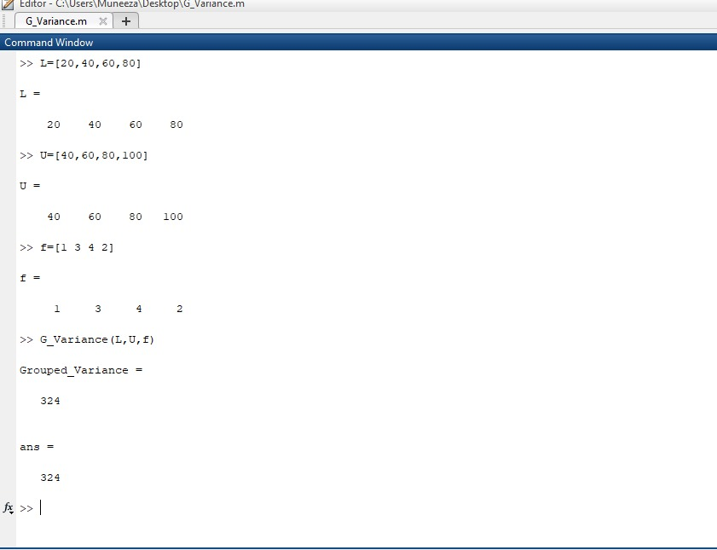
Output of Grouped Variance

Slide 31
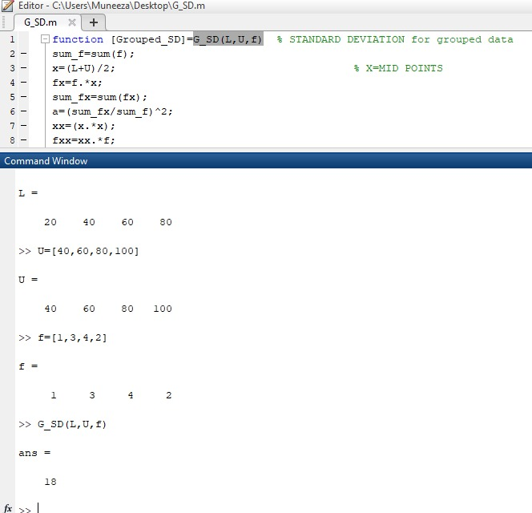
Output of Grouped Standard deviation

Slide 32
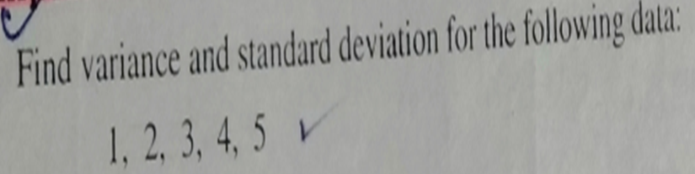
Co-efficient of Variation
Compute the Co-efficient of Variation of the following data

Slide 33
Ungrouped Function coff_V
function[Coefficient_of_Variation_for_Ungrouped_Data] = CV_UG(x) % COEFFICIENT OF VARIATION FOR UNGROUPED DATA
n = length(x); % n=NUMBER OF OBSERVATIONS
sum_x = sum(x);
k = (sum_x/n);
a = k^2;
xx = x.*x;
sum_xx = sum(xx);
b = (sum_xx/n);
c = sqrt(b-a);
Coefficient_of_Variation_for_Ungrouped_Data = (c/k)*100;
end

Slide 34
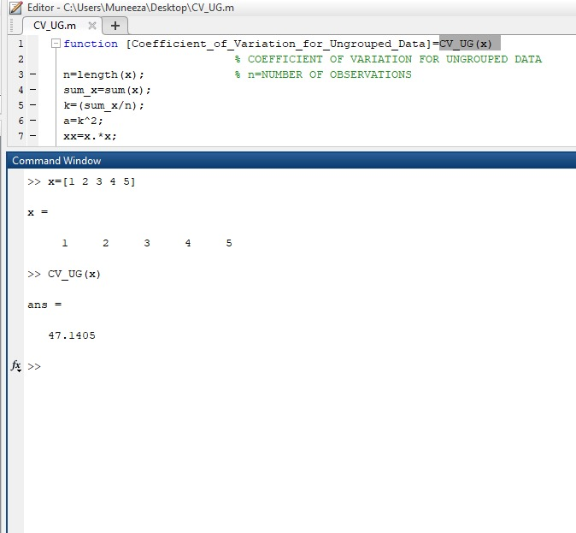
Output of Co-efficient of Variation (UG)

Slide 35
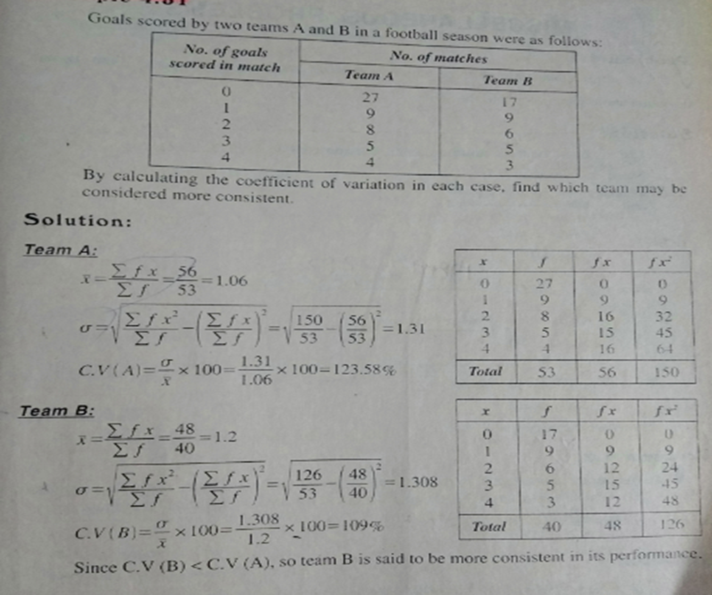
Grouped Coefficient of Variance and Standard Deviation
Compute Coefficient of Variance and Standard Deviation of the following data

Slide 36
Grouped Function
function [ Coefficient_of_variation_of_Team_A , Coefficient_of_variation_of_Team_B ]=CV_G(x,f1,f2) % COEFFICIENT OF VARIATION FOR GROUPED DATA
sum_f1=sum(f1);
sum_f2=sum(f2);
f1x=f1.*x;
f2x=f2.*x;
sum_f1x=sum(f1x);
sum_f2x=sum(f2x);
a1=(sum_f1x/sum_f1);
a2=(sum_f2x/sum_f2);
k1=a1^2;
k2=a2^2;
x1x1=(x.*x).*f1;
x2x2=(x.*x).*f2;
sum_f1x=sum(x1x1);
sum_f2x=sum(x2x2);
b1=(sum_f1x/sum_f1);

Slide 37
b2 = (sum_f2x/sum_f2);
c1=sqrt(b1-k1);
c2 = sqrt(b2-k2);
C.V_1 = (c1)/a1*100; % COEFFICIENT OF VARIATION OF TEAM A
Coefficient_of_variation_of_Team_A = C.V_1
C.V_2 = (c2)/a2*100; % COEFFICIENT OF VARIATION OF TEAM B
Coefficient_of_variation_of_Team_B = C.V_2
if(C.V_1<C.V_2)
disp("TEAM A IS MORE CONSISTENT IN ITS PERFORMANCE")
else
disp("TEAM B IS MORE CONSISTENT IN ITS PERFORMANCE")
end
end

Slide 38
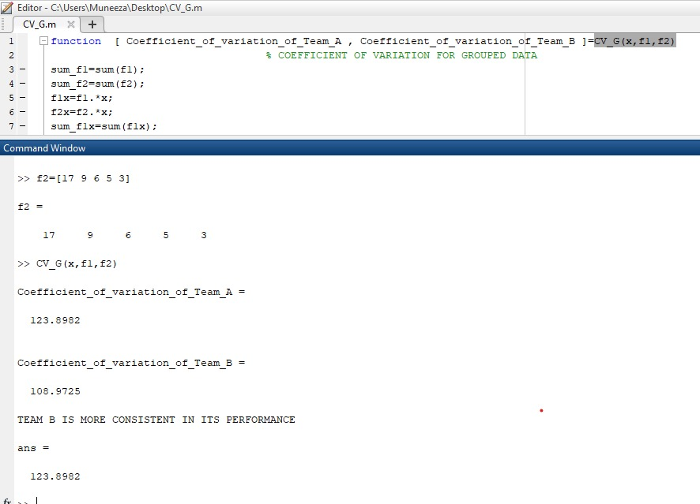
Output of Grouped Co-efficient of Variation & SD

